Slide 1
Prediction Deposito Using Supervised Learning
DATA SCIENCE

Slide 2
Background Project
In a bank there are several customers who make deposits to the bank. Each customer has different conditions, ranging from age, income and other dependents. The bank has some data on customers who make deposits or not. This bank wants to make a prediction of conditions that cause banks to make deposits or not. Therefore the data science team conducted an analysis using the machine learning method to help the bank make a decision when it wants to find customers who will make deposits.

Slide 3

Datasheet
Data input:
Age : Age of Umur Customer. Job : Customer's job. Martial : Status Married, Single, and Divorced. Education : Education owned by the customer.. Default : Have credit or not. Balance : Customer income every month. Housing : Have a mortgage or not. Loan : Have a loan or not. Contact : Contacting customers using telephone or cellular. Day : Last day contacted. Month : Last month contacted. Duration : The duration of the last contact was called. Campaign : The number of contacts made during the campaign. Pdays : last contact the client based on the campaign. (999 is null) Previous : The number of contacts made before the campaign. Poutcome : Results from previous marketing campaigns.
Output/Target :
y : Customers who make deposits

Slide 4
TABLE OF CONTENTS
01
02
03
MODELING - INSIGHT
PROBLEM & GOALS
ARCHITECUTRE -DATA ANALYSIS

Slide 5
UNDERSTANDING THE PROBLEM
Sub-Problem
Main-Problem
- What are the characteristics of customers who make deposits?
- How About Correlation data between data input and output/target ?
- Which is good model for prediction?
How to know the customer made a deposit?

Slide 6
PROBLEM OUR GOALS
Find data that correlates with the
output/target by knowing the
characteristics of customers based on
existing data.
Make a model that is effective and can be used for predictions.
Facilitate the bank in finding customers and right on target thereby reducing time, costs, and effort

Slide 7
ARCHITECTURE

Slide 8
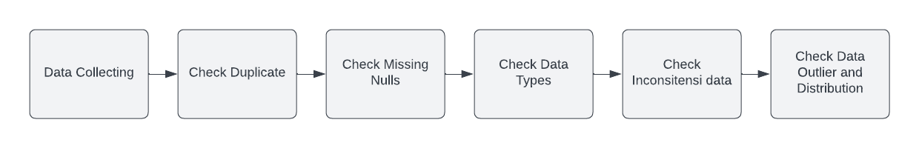
ARCHITECTURE – DATA PREPOCCESING

Slide 9
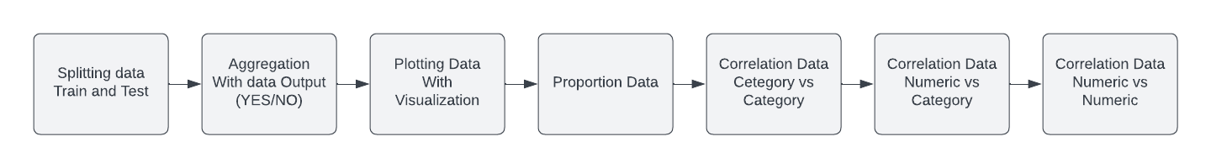
ARCHITECTURE – EKSPLORATORY DATA ANALYSIS

Slide 10
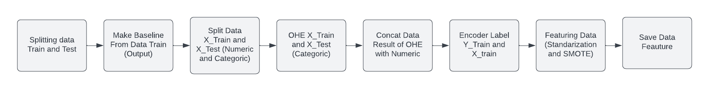
ARCHITECTURE – FEAUTURE ENGINEERING

Slide 11
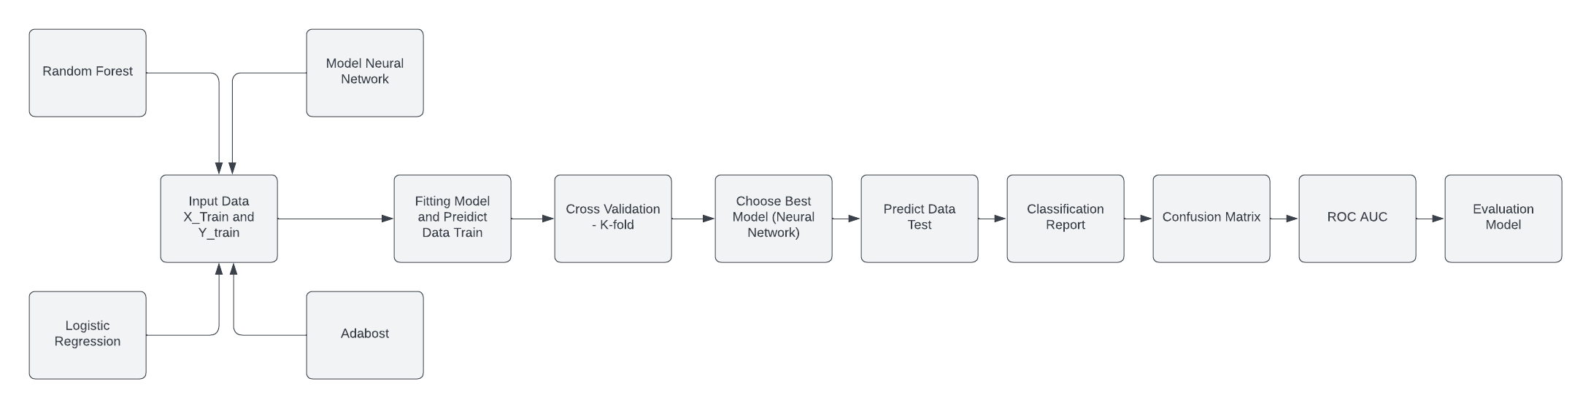
ARCHITECTURE – MODELING

Slide 12
EKSPLORATORY DATA ANALYSIS

Slide 13
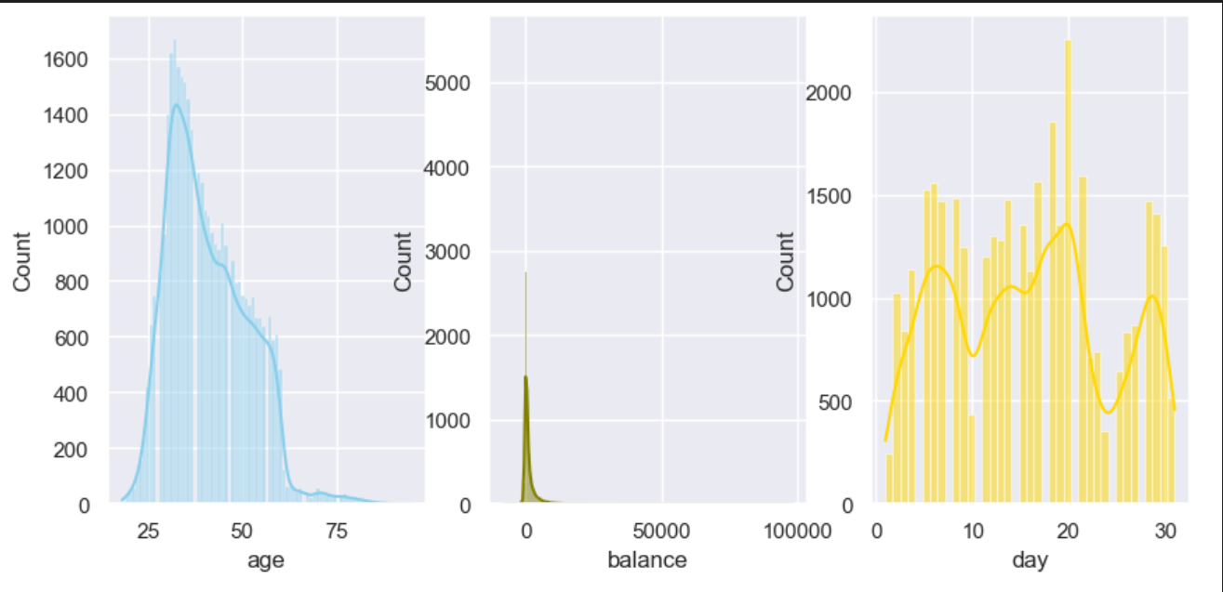
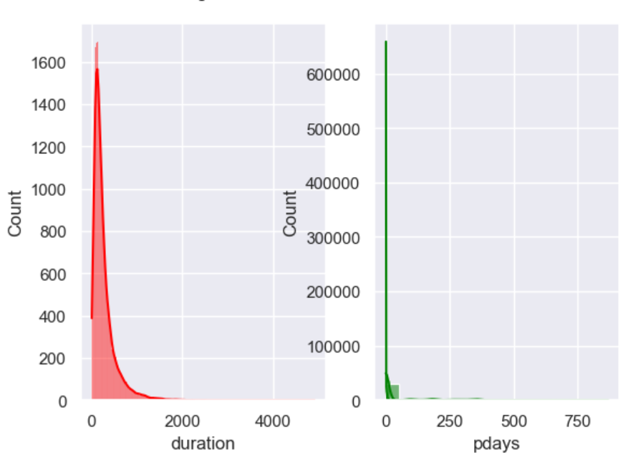
Visualization - Distribution

Slide 14
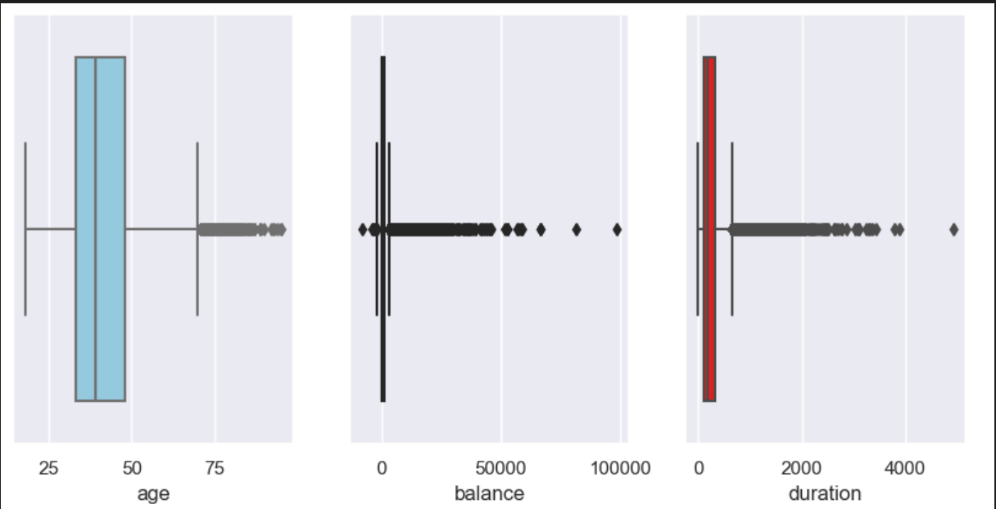
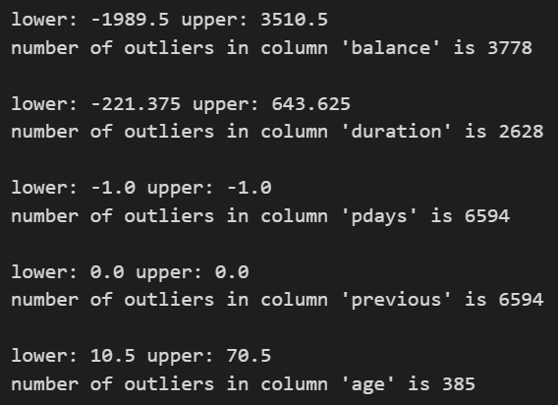
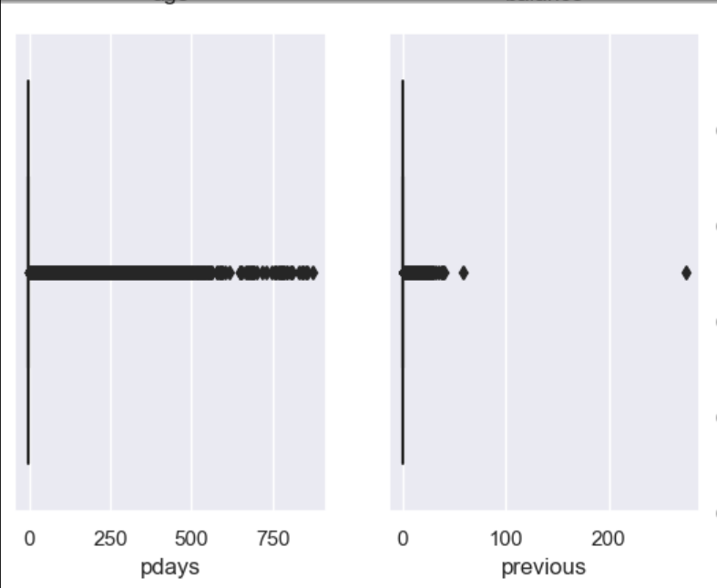
Visualization - Outlier
Boxplot
Sum of Outlier

Slide 15

Answer Sub-Problem
What are the characteristics of customers who make deposits?

Slide 16


Agrregation - Median
Because Distribution data is Skew Positif (Median)
Median Output (Yes) :
- Age = 38 - Duration = 429
- Balance = $755k
Median Output (No):
- Age = 39 - Duration = 416
- Balance = $164K

Slide 17
Agrregation - Grouping
New Insight by 'No' condition:
Background:
- sum of 'No' condition for job the highest is 'blue-coller’
- sum of 'No' condition for marital the highest is 'married’
- sum of 'No' condition for education the highest is 'secondary’
Dependent :
- sum of 'No' condition for default the highest is 'no’
- sum of 'No' condition for housing the highest is 'yes’
- sum of 'No' condition for loan the loan is ‘no’
Contact:
- sum of 'No' condition for contact the contact is 'celluler’
- sum of 'No' condition for poutcome the poutcome is 'unkown’
- sum of 'No' condition for month the month is 'may'
New Insight by 'Yes' condition:
Background:
- sum of 'yes' condition for job the highest is 'Manajemen’
- sum of 'yes' condition for marital the highest is 'married’
- sum of 'yes' condition for education the highest is 'secondary’
Dependent:
- sum of 'yes' condition for default the highest is 'no’
- sum of 'yes' condition for housing the highest is 'no’
- sum of 'yes' condition for loan the loan is ‘no’
Contact:
- sum of 'yes' condition for contact the contact is 'celluler’
- sum of 'yes' condition for poutcome the poutcome is 'unkown’
- sum of 'yes' condition for month the month is 'may'

Slide 18
Answer Sub-Problem
How About Correlation data between data input and output/target ?

Slide 19
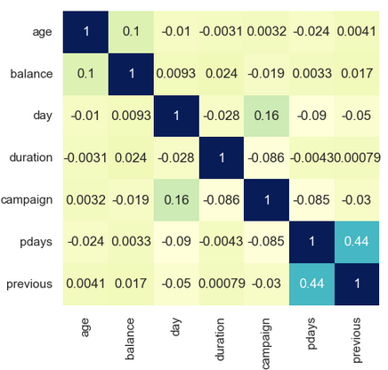

Correlation
Numeric VS Numeric:
Category VS Category:
Chi-square Method = P-Value < 0.05
Numeric VS Numeric :
Spearmanr Method
Duration VS Output : 0.32

Slide 20
MODELING

Slide 21
How to Model Work

Slide 22
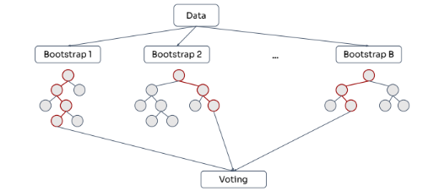
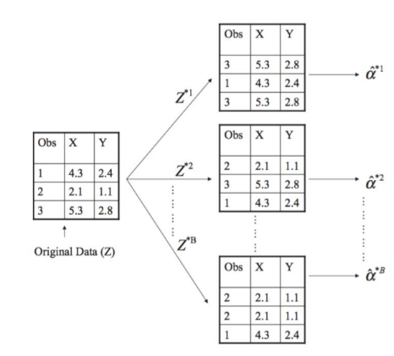
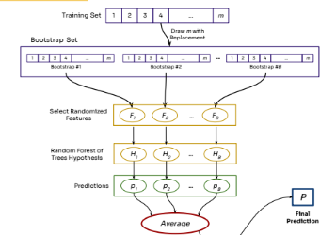
How the Random Forest Model works
Random goals to improve performance
Because the trees are not correlated with each other
How bootstrap works
Take random sample
Random feauture
Random Forest
Prediction
Final (Avarage predict)

Slide 23
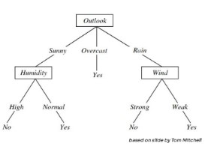
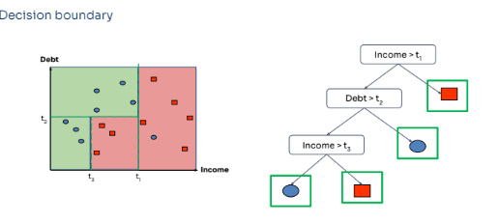
How the Random Forest Model works
Model using : 200 Decision Tree (n_estimators = 200) > by using more decision trees, we can reduce overfitting and improve prediction accuracy on new data
How the Decision Tree Works

Slide 24
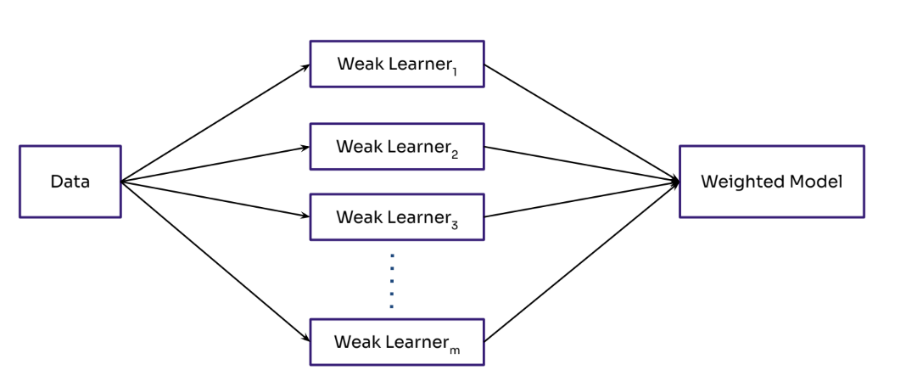
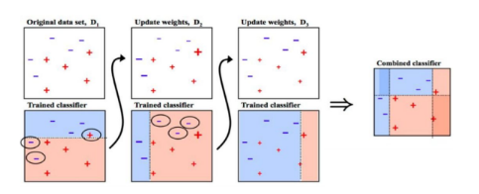
How the Adabost Model works
- Hyperparameter model
base_estimator = DecisionTreeClassifier(max_depth=5) # model selection
n_estimators=100
learning_rate=0.1

Slide 25
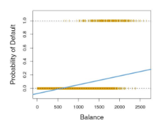
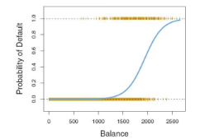
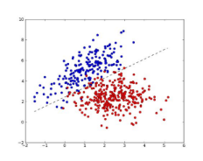
How the Logistic Regression Model works
Make Linier Model
“Squashed” between 0 and 1
class_weight="balanced"
Decision boundary
> threshold 0.5

Slide 26
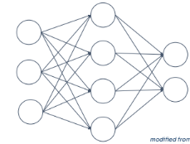
How the Neural Network Model works
Model Sequential
Hidden Layer (128 neuron)
activation softmax(multiclass)
Output Layer
/ Result (1 output)
Range 0 - 1
Input layer
10 data

Slide 27
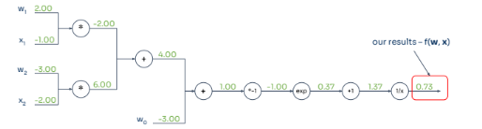
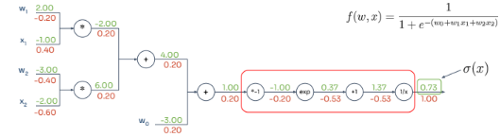
How the Neural Network Model works
How to work model from input to output ?
How to find gradient error? For update weight
Forward Propagation
(Computation garhp)
Backward Propagation
(Computation garhp)

Slide 28
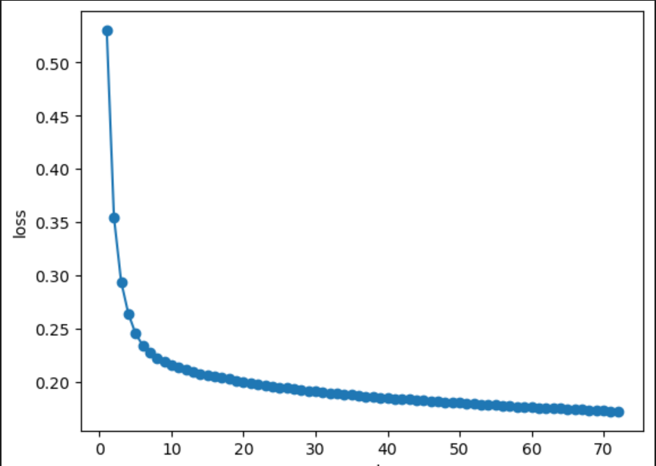
How the Neural Network Model works
Make Model
model = keras.Sequential() # input kind model
model.add(layers.Dense(128, activation = "softmax",input_shape=(X_train_clean.shape[1],))) # for input data
Dropout(0.5) # drop dense if not used
model.add(layers.Dense(1, activation="sigmoid")) # output dense for data
model.add(Flatten()) # converts the multi-dimensional tensor to a one-dimensional form in the output (Reduce complexity).
opt = Adam(learning_rate = 0.001)
loss = "binary_crossentropy"
This loss function will calculate the difference between the predicted value and the target value, then try to minimize this difference during the model training process.
Fitting Model
epochs = 500, # 500 full cycle
validation_split=0.2, # split data when model running
batch_size = 64, # make category as big as 64 batch (data divide 64 batch for 1 epoch)
callbacks=[keras.callbacks.EarlyStopping(patience=50)], # for stopping if model overfitting

Slide 29
Result Model

Slide 30
Fitting Model (Data Train)
Using Data Feauture (Standartization) = All model except Random Forest
Using Data Feauture (SMOTE) = Model Random Forest
Baseline = 0.88
Fitting Model
Random Forest
Logistic Regression
Adabost
Neural Network
Accuracy = 1.0
Accuracy = 0.85
Accuracy = 0.92
Accuracy = 0.92

Slide 31
Cross Validation : K-Fold (Data Train)
Cross Validation
Random Forest
Adabost
Neural Network
Accuracy = 0.88
Accuracy = 0.90
Accuracy = 0.92

Slide 32
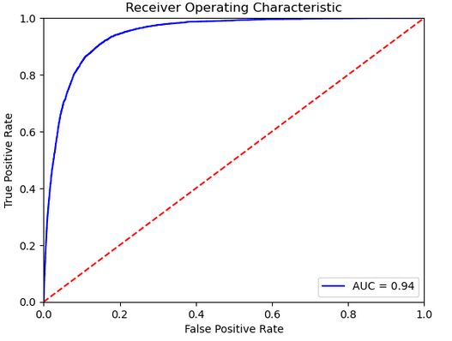
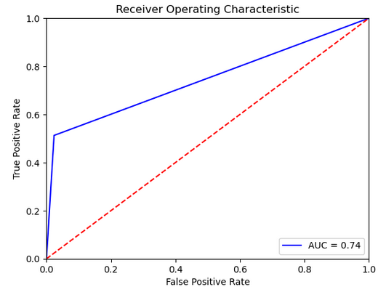
ROC AUC : Data Train
Neural Network
ADABOST

Slide 33
Answer Sub-Problem
Which is good model for prediction?

Slide 34
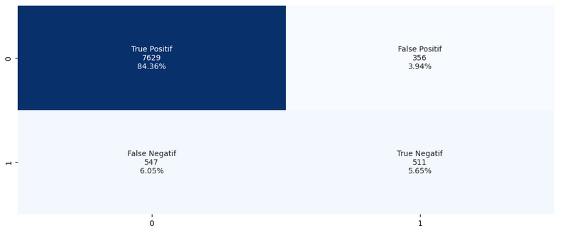
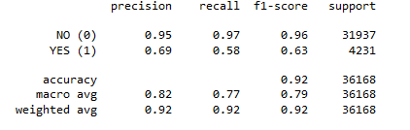
Neural Network Model: Data Train
Confusion
Matrix
ROC/AUC
Classification Report

Slide 35
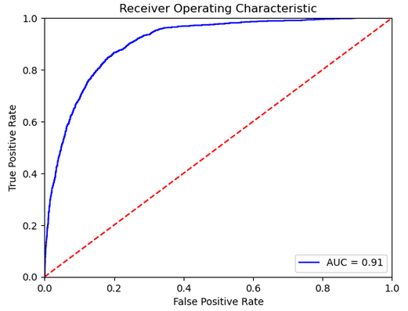
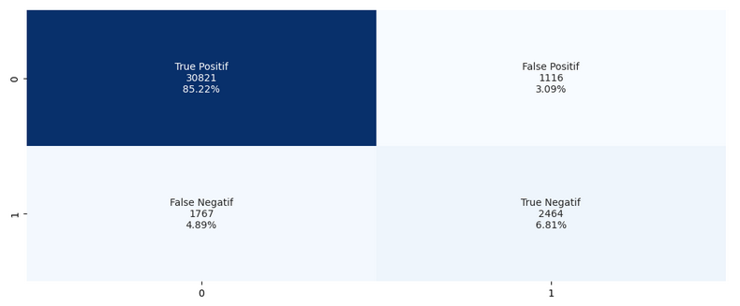
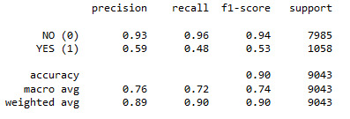
Neural Network Model: Data Test
Confusion
Matrix
ROC/AUC
Classification Report

Slide 36
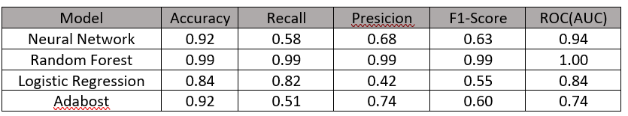
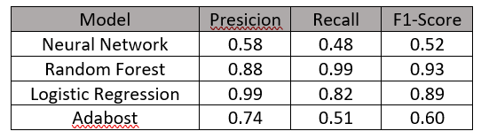


Evaluation Model :
True Positif Rate (TPR) – Class 0 (No)
True Negatif Rate (TNR) – Class 1 (Yes)
Data Train :
Data Train :
Data Test :
Data Test :

Slide 37
Conclution

Slide 38
Conclution
- The highest correlation in numerical data is 'Duration' of 0.343.
- The category input data has a p-value below 0.05 with the output data so that the category data are correlated with each other.
- The correlation between input and output data affects the results of the modeling used, the more uncorrelated the lower the model value.
- The Neural Network Model is the best model in this experiment because this model uses deep learning so it can be better for increasing ROC AUC than the other three models.
- Nueral Network Model, TPR 'NO' Output gets an F1-Score of 0.63 : 0.63 while the TNR 'YES' output gets an F1-Score of 0.52 : 0.63.
- Hyperparameters determine the model's overfitting, underfitting, and metrics values.
- Imbalance data does not always use SMOTE or other methods that turn data into a balance, this is related to model compatibility, there are several models that are more suitable for solving imbalanced data without balance or vice versa.
- Not all models require a scaling process like the Random Forest model because they do not require the input data to have a normal distribution or have the same scale.
- Learning rate and batch size in training play a big role in the neural network model, the faster the learning rate and the more batch size it causes overfitting.
- Imbalance data needs to focus on the ROC AUC because it can distinguish between positive and negative instances.

Slide 39
Insight business

Slide 40
Insight-1 :
In the case of deposits, we focus on the metrics f1-score (63%) because we need to balance recall and
Precision .
- The 2nd matrix that needs to be considered is recall because it needs to recognize data so that it is not missed
When a customer wants to make a deposit (class 0 (48%) and 1 (58%) )
- The neural network model is able to recognize the data by 48% which means 62%
It is possible that the customer is actually interested in making a deposit but missed it (FN).
- The neural network model is capable of precisioning the data by 58%, which means equal to
42% chance of actually not being interested but contacted (TN)
Advantages of the model using f1-score:
A good F1-score indicates that the model has a good ability to classify customers
which has the potential to open deposits correctly, thereby increasing the effectiveness of the campaign
deposit marketing and reduce costs incurred to contact disinterested customers.
In addition, with a good F1-score, banks can improve the model's accuracy in predicting customers
which has the potential to open deposits and maximize opportunities to increase deposit sales.

Slide 41
Insight-2 :
Data which influence customer makes a deposit is :
- Background : Job, Martial, and Education
- Dependent : Default, Housing, and Loan
- Contact : Duration, Poutcome, month dan Contact is unity
that affects the largest models is Duration
My recommendation :
That has a P-Value = 0.004:
- Job = Manajemen
- Eductaion = Secondary
Different dependent from deposito or not is ‘housing’, because if customer have a house installment
majority they do not deposito.

Slide 42


